Slide 1
Introduction to Linear Predictive Modelling
Tim Smith

Slide 2

Predictive Modeling
Goal: build a representational model of a relationship between input and target values that predicts target measures that we have not yet seen.
Input
Hidden
Relationship
Target
Representational Model
Predicted
Target
The “hidden relationship” produces the target we are attempting to “hit”.
A representation model attempts to “hit” the target.

Slide 3
Summary - Key Issues in Predictive Analytics
Two important issues that we need to consider for all modeling in predictive analytics…
Data “Fit”:
Over-Fitting: If our model is too specific in describing our existing/current data that we have used to fit our model, we may limit the models ability to predict data that we have not yet evaluated.
Under-Fitting: If our model is too general, we may limit the models ability to accurately predict data that has not yet been seen.
Model complexity:
Complex models introduce more assumptions than less complex models. Therefore, within reason, less complex models are preferred.
Complex models are more difficult to interpret, communicate and understand.
Complex models require more processing, and for time sensitive forecasts, this can be a big deterrent.
But, simple models may not capture the patterns exhibited by any underlying process or relationship being observed.

Slide 4
Some other issues to consider… Sampling Methods & Input Relevancy/Reduction

Slide 5
Modeling Pitfalls: Population Drift
Data generated
Data cleaned
Model deployed
Time
Data analyzed
Data acquired

Slide 6
Identifying and measuring high quality inputs:
Fraud
OK
Time of Day
Transaction Amt.
...

Slide 7
The Secret to Better Predictions
Fraud
Bad Credit
Score
OK
Time of Day
Time of Day
Transaction Amt.
Transaction Amt.

Slide 8
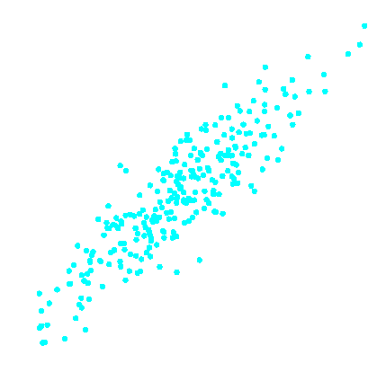


Identifying an eliminating low/poor quality inputs:
Redundancy
Irrelevancy
x₂
x₄
0.70
0.60
0.50
0.40
x₁
x₃
Note: The above lines are isoquants of y

Slide 9
Input Reduction – Redundancy
Redundancy
Irrelevancy
x₂
x₄
0.70
Input x₂ has the same information as input x₁.
0.60
0.50
0.40
x₁
x₃
Example: x1 is household income and x2 is home value.

Slide 10
Input Reduction – Irrelevancy
Redundancy
Irrelevancy
x₂
x₄
0.70
Predictions change with input x₄ but much less with input x₃.
0.60
0.50
0.40
x₁
x₃
Example: Target is response to direct mail solicitation. x3 is religious affiliation, and x4 is the response to previous solicitations.

Slide 11
No let’s look at Python code…

